Slide 1

PORTFOLIO-HONGHE QI
qihhhanks@gmail.com
hongheqi2020@u.northwestern.edu
+1 (414)-578-0392

Slide 2
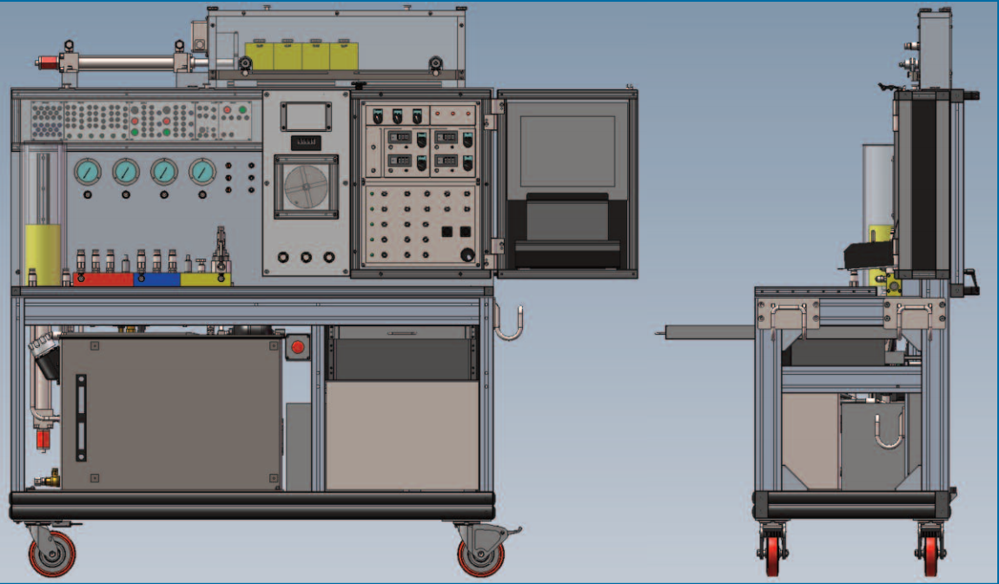
MSOE Hydraulic Training Stand (SolidWorks/ANSYS)

Slide 3
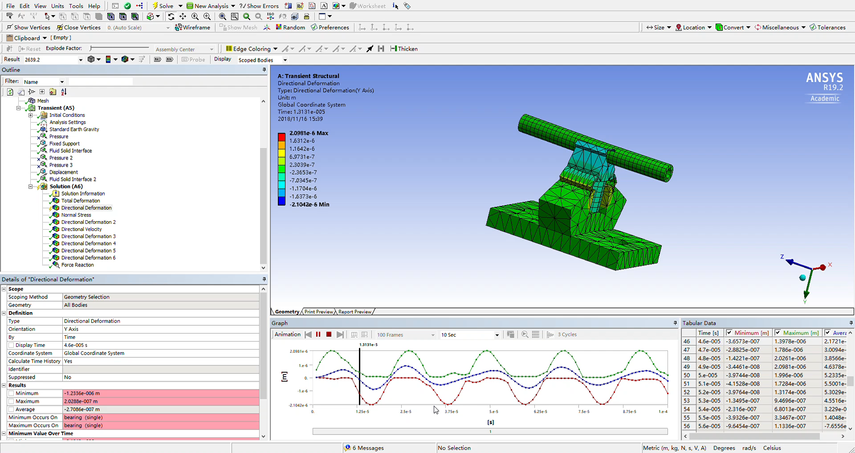
Ultra-sonic Air Bearing Levitation Force Simulation(ANSYS)
Click to Play

Slide 4
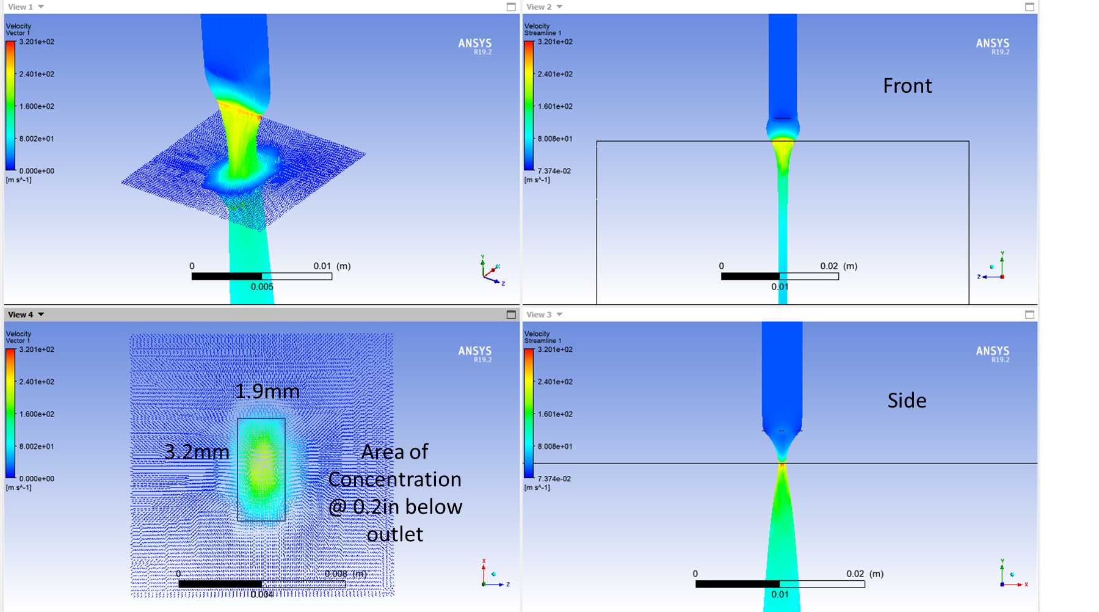
CFD For Additive Manufacturing Powder Nozzle (ANSYS)

Slide 5
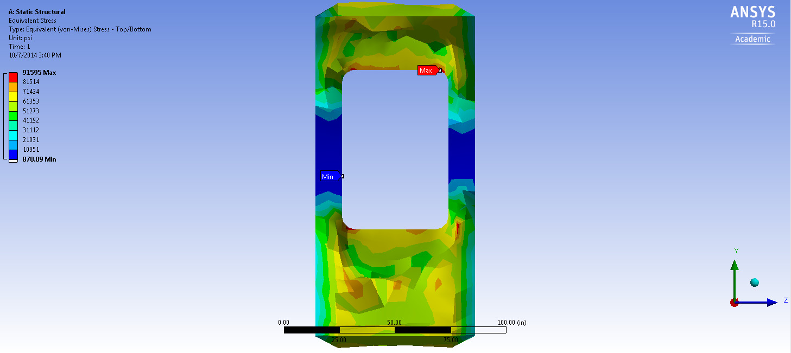
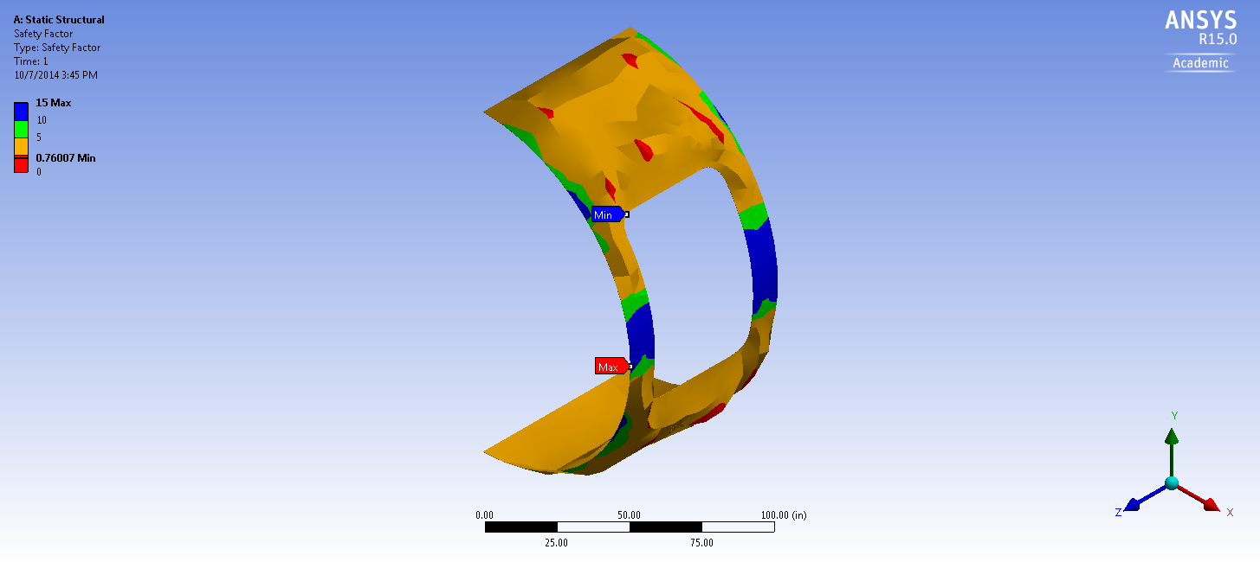
FEA on Aircraft Panel Under Load(ANSYS)

Slide 6
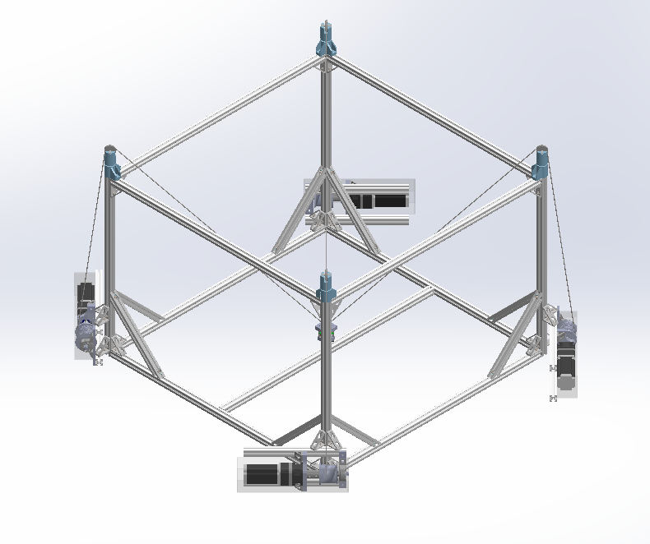
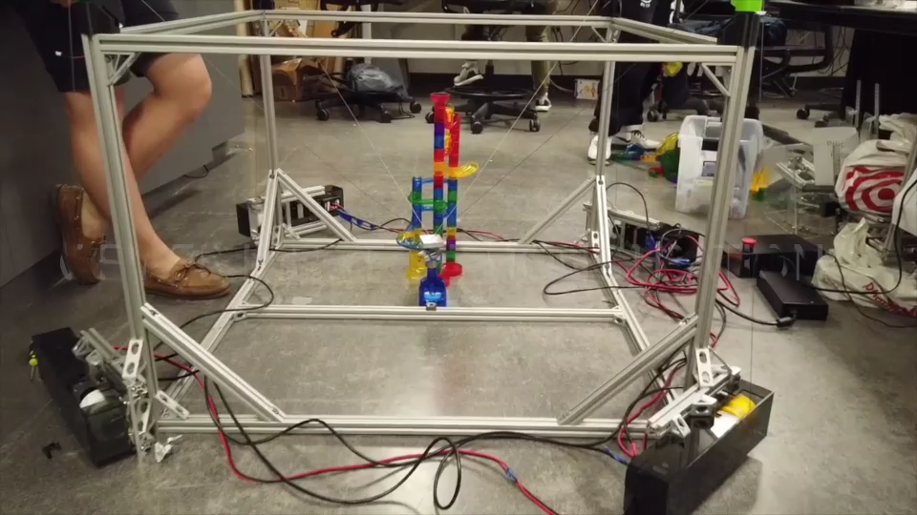
Cable-driven Robot (SolidWorks/ANSYS/Rapid Prototyping/CNC)
Click to Play

Slide 7
Designed more than 20 vibratory conveyors and feeders. Unfortunately, they cannot be shown due to NDA.

Slide 8
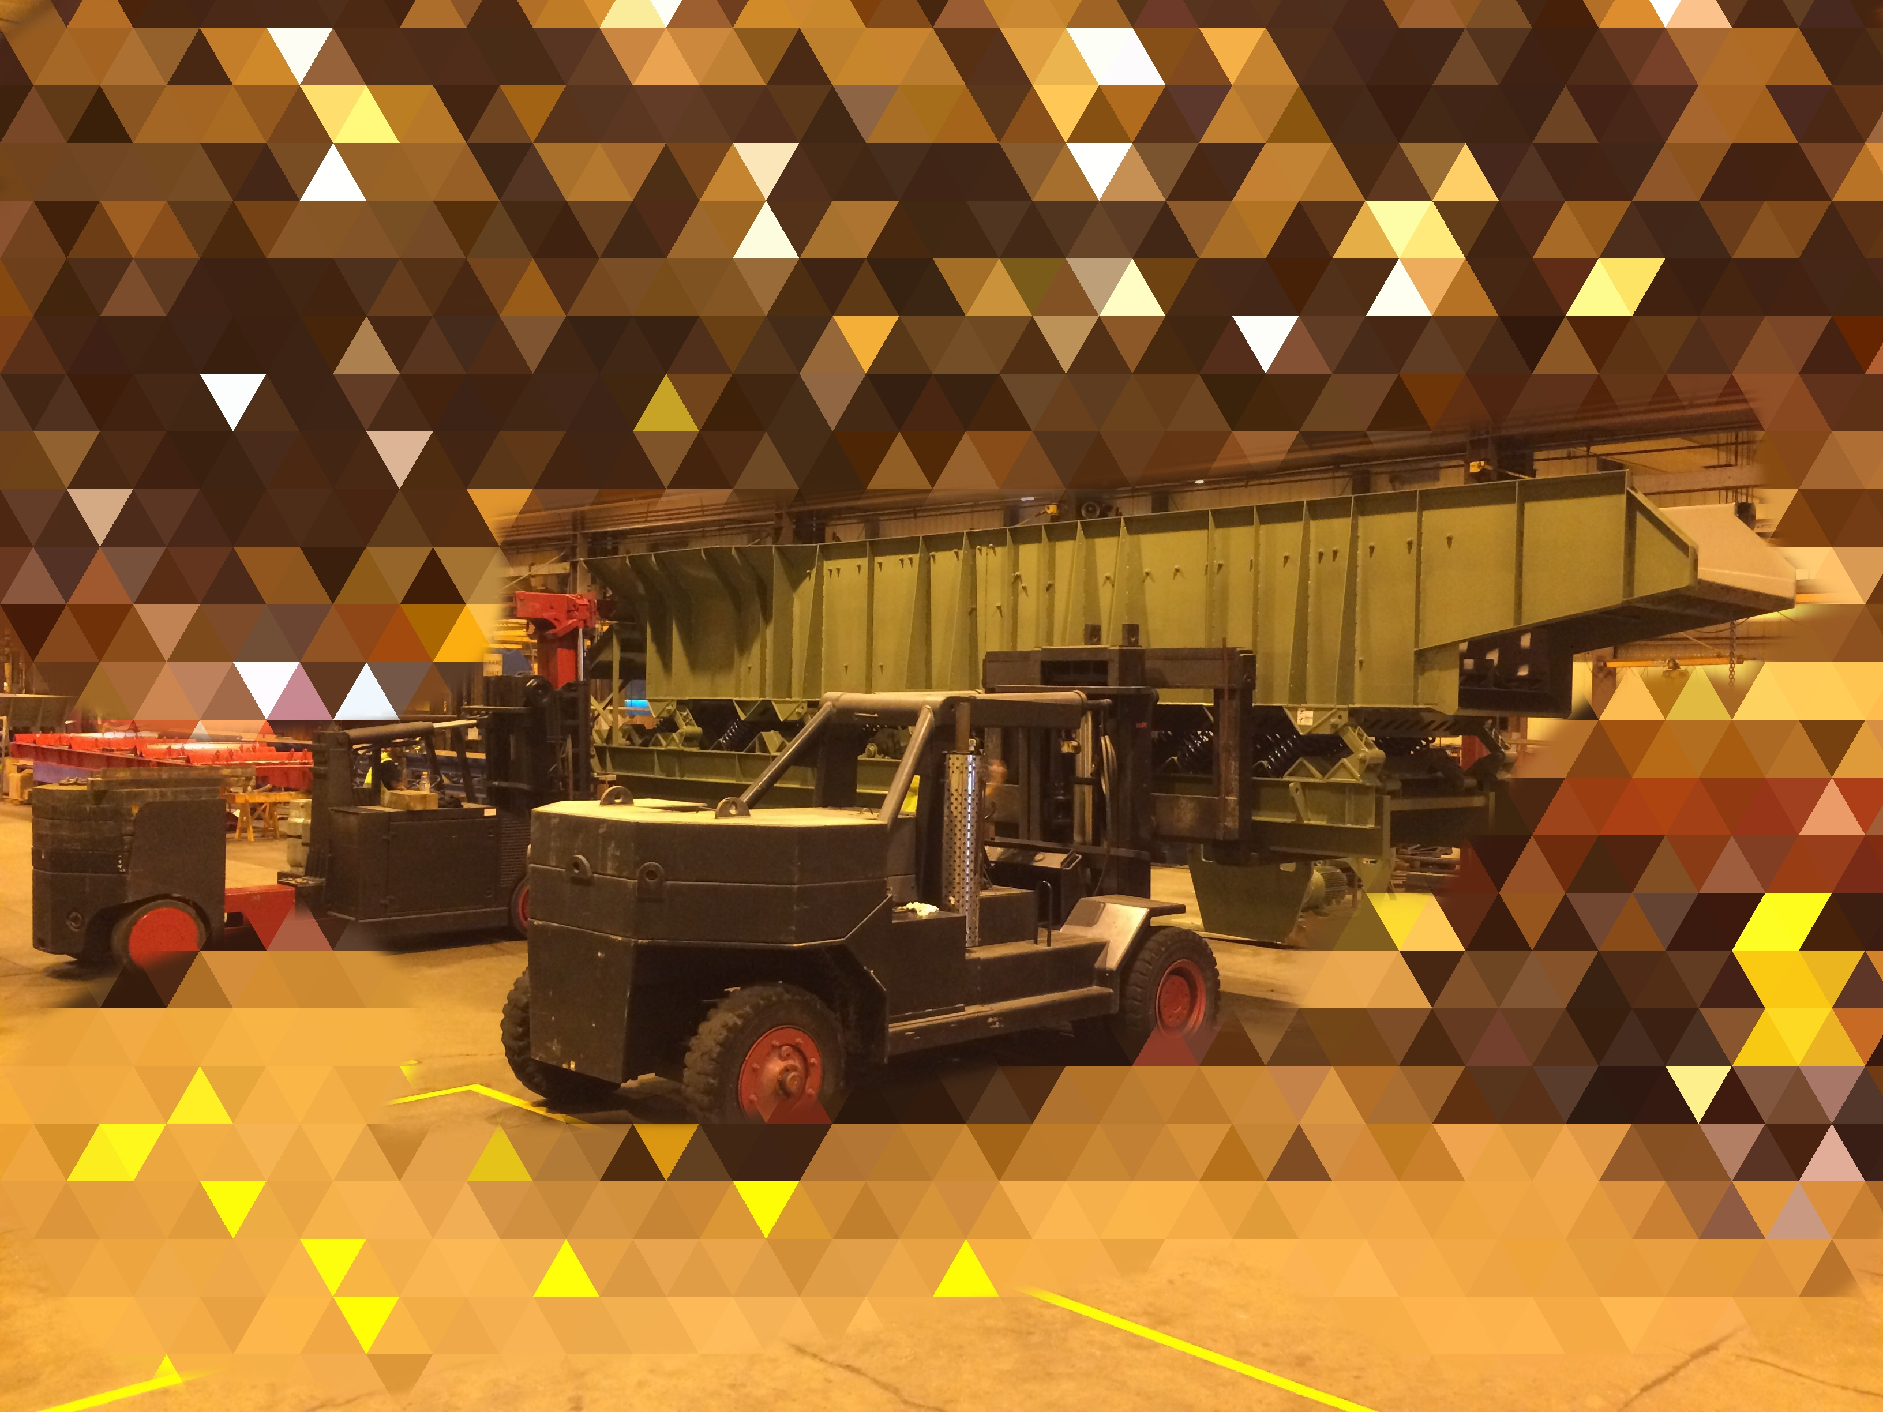
Vibratory Feeder (Inventor/ANSYS)

Slide 9
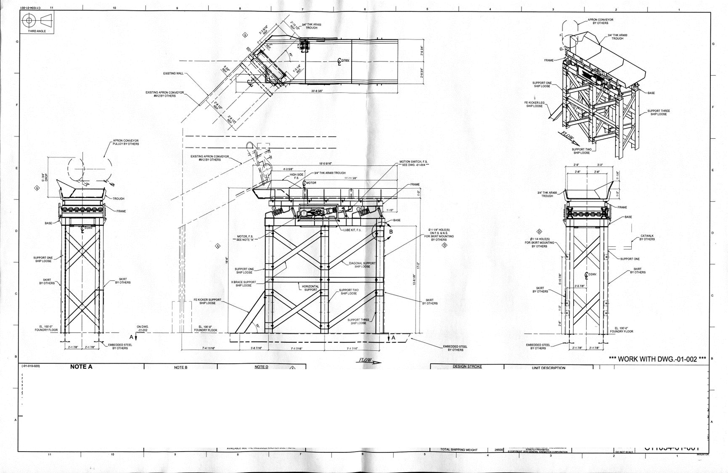
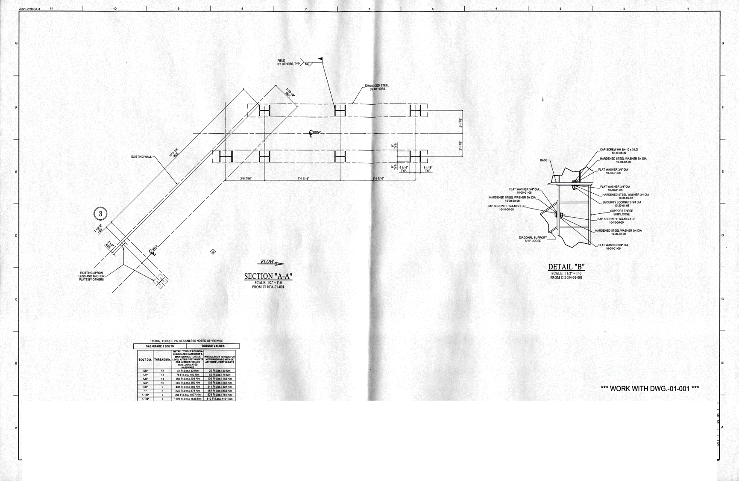
Vibratory Conveyor (Inventor/ANSYS)

Slide 10
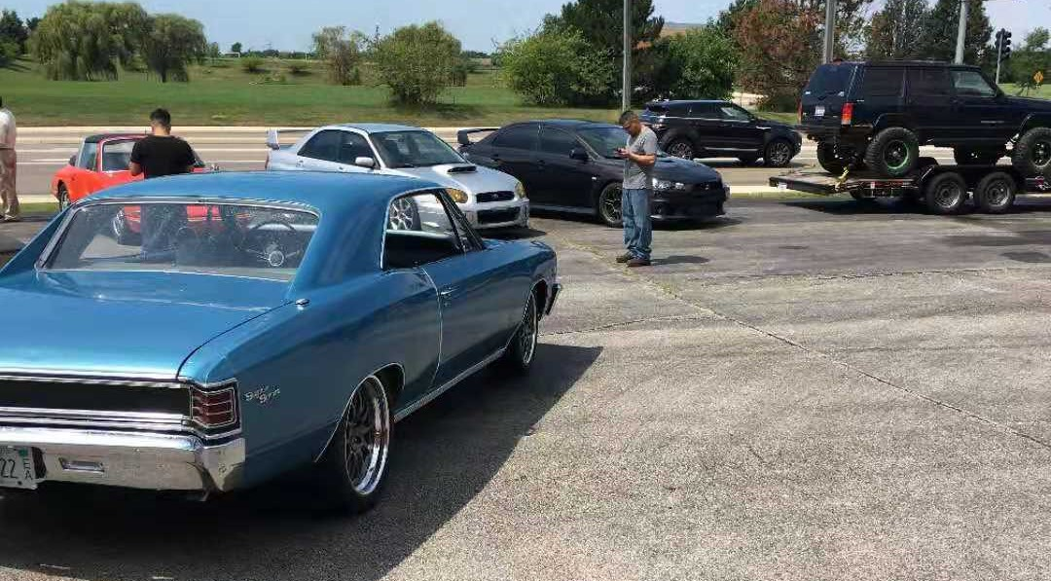
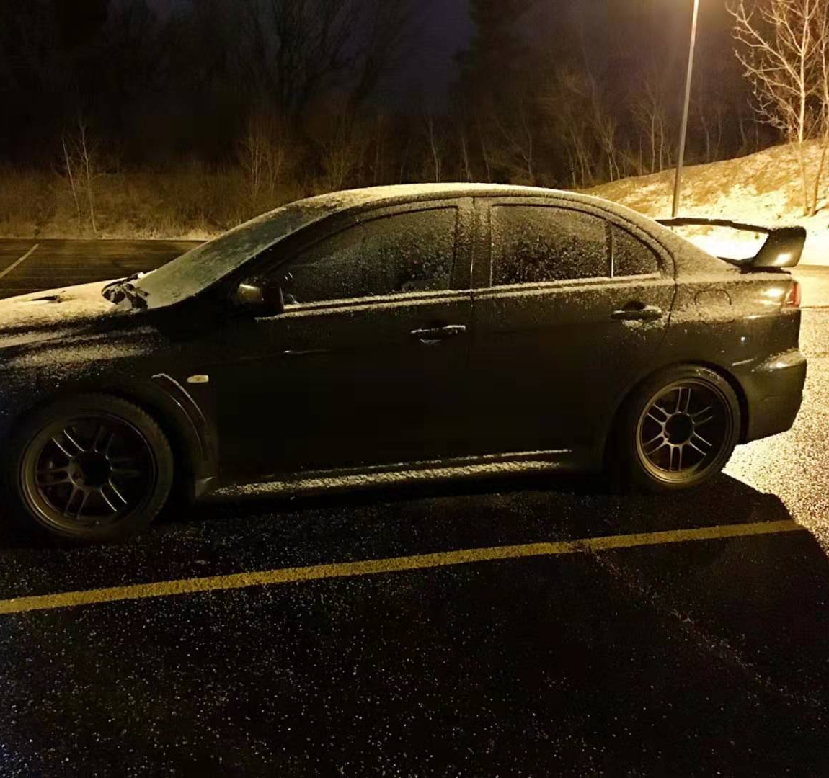
I Also Love Working On My EVO!
There she is

